Slide 1
Chapter 6: Process Synchronization
Background
The Critical-Section Problem
Synchronization Hardware
Semaphores
Classical Problems of Synchronization
Critical Regions
Monitors
Synchronization in Solaris 2 & Windows 2000

Slide 2
Producer
while (true) {
/* produce an item and put in nextProduced */
while (count == BUFFER_SIZE)
; // do nothing
buffer [in] = nextProduced;
in = (in + 1) % BUFFER_SIZE;
count++;
}

Slide 3
Consumer
while (true) {
while (count == 0)
; // do nothing
nextConsumed = buffer[out];
out = (out + 1) % BUFFER_SIZE;
count--;
/* consume the item in nextConsumed
}

Slide 4
Race Condition
count++ could be implemented as
register1 = count
register1 = register1 + 1
count = register1
count-- could be implemented as
register2 = count
register2 = register2 - 1
count = register2

Slide 5
Bounded Buffer
Assume counter is initially 5. One interleaving of statements is:
producer: register1 = counter (register1 = 5)
producer: register1 = register1 + 1 (register1 = 6)
consumer: register2 = counter (register2 = 5)
consumer: register2 = register2 – 1 (register2 = 4)
producer: counter = register1 (counter = 6)
consumer: counter = register2 (counter = 4)
The value of count may be either 4 or 6, where the correct result should be 5.

Slide 6
Bounded Buffer
If both the producer and consumer attempt to update the buffer concurrently, the assembly language statements may get interleaved.
Interleaving depends upon how the producer and consumer processes are scheduled.

Slide 7
Bounded Buffer
Concurrent access to shared data may result in data inconsistency.
Maintaining data consistency requires mechanisms to ensure the orderly execution of cooperating processes.
Atomic operation means an operation that completes in its entirety without interruption.

Slide 8
Race Condition
Race condition: The situation where several processes access – and manipulate shared data concurrently. The final value of the shared data depends upon which process finishes last.
To prevent race conditions, concurrent processes must be synchronized.

Slide 9
The Critical-Section Problem
n processes all competing to use some shared data
Each process has a code segment, called critical section, in which the shared data is accessed.
Problem – ensure that when one process is executing in its critical section, no other process is allowed to execute in its critical section.

Slide 10
Solution to Critical-Section Problem
1. Mutual Exclusion. If process P_{i} is executing in its critical section, then no other processes can be executing in their critical sections.
Progress. If no process is executing in its critical section , and there exist some processes that wish to enter their critical section, then the selection of the processes that will enter the critical section next cannot be postponed indefinitely.---
and the selection decision is made by the processes which is willing to enter critical section.
3

Slide 11
Solution to Critical-Section Problem
3. Bounded Waiting. A bound must exist on the number of times that other processes are allowed to enter their critical sections after a process has made a request to enter its critical section and before that request is granted.
Assume that each process executes at a nonzero speed
No assumption concerning relative speed of the n processes.

Slide 12
two-process solution
Only 2 processes, P₀ and P₁
General structure of process P_{i} (other process P_{j})
do {
entry section
critical section
exit section
reminder section
} while (1);
Processes may share some common variables to synchronize their actions.

Slide 13
Algorithm 1
Shared variables:
  int turn;
  initially turn = 0
  turn = i ⇒ P_{i} can enter its critical section
Process Pi
do {
while (turn != i) ;
/*critical section*/
count ++;
turn = j;
reminder section
} while (1);

Slide 14
Algorithm 1
process 0
do {
while (turn != 0) ；
/*critical section*/
count ++;
turn = 1;
reminder section
} while (1);
process 1
do {
while (turn != 1) ;
/*critical section*/
count - -;
turn = 0;
reminder section
} while (1);
Satisfies mutual exclusion, but not progress

Slide 15
Algorithm 1
problem
  if one process executes in remainder section for ever

Slide 16
Algorithm 2
Shared variables
  boolean flag[2];
  initially flag [0] = flag [1] = false.
  flag [i] = true ⇒ P_{i} ready to enter its critical section
Process P_{i}
do {
flag[i] = true;
while (flag[ j ]) ;
critical section
flag [i] = false;
remainder section
} while (1);
Satisfies mutual exclusion, but not progress requirement.

Slide 17
Algorithm 2
problem
if
  flag[ i ] = true;
  flag[ j ] = true;

Slide 18
Algorithm 3
  int turn;
  Boolean flag[2]
Process P_{i}
do {
flag [ i ] = true;
turn = j;
while (flag [ j ] && turn == j ) ;
critical section
/****** comment **********/
flag [ i ] = false;
remainder section
} while (1);
Meets all three requirements; solves the critical-section problem for two processes.

Slide 19
Algorithm 3
  int turn;
  Boolean flag[2]
Process P_{i}
do {
flag [ i ] = true;
turn = j;
while (flag [ j ] && turn
== j ) ;
critical section
/****** comment **********/
flag [ i ] = false;
remainder section
} while (1);
  int turn;
  Boolean flag[2]
Process P_{j}
do {
flag [ j ] = true;
turn = i;
while (flag [ i ] &&
turn == i ) ;
critical section
/****** comment **********/
flag [ j ] = false;
remainder section
} while (1);

Slide 20
Algorithm 3
Question ????????:
do {
flag [ i ]:= true;
turn = i; /*not j */
while (flag [ k ] && turn == k ) ;
critical section
/****** comment **********/
flag [ i ] = false;
remainder section
} while (1);

Slide 21
Bakery Algorithm
Critical section for n processes
Notation <≡ lexicographical order (ticket #, process id #)
  (a,b) < (c,d) if a < c or if a = c and b < d
  max (a₀,…, a_{n-1}) is a number, k, such that k ≥ a_{i} for i - 0,
  …, n – 1
Shared data
boolean choosing[n];
int number[n];
Data structures are initialized to false and 0 respectively

Slide 22
Before entering its critical section, process receives a number. Holder of the smallest number enters the critical section.
If processes P_{i} and P_{j} receive the same number, if i < j, then P_{i} is served first; else P_{j} is served first.
The numbering scheme always generates numbers in increasing order of enumeration; i.e., 1,2,3,3,3,3,4,5...

Slide 23
Bakery Algorithm
do {
choosing[i] = true; ///////////////////////////////////////////////////??????
number[i] = max(number[0], number[1], …, number [n – 1])+1;
choosing[i] = false;
for (j = 0; j < n; j++) {
while (choosing[j]) ;
while ((number[j] != 0) && ((number[j],j) < (number[i],i))) ;
}/////////////////////////////////////////////////////////////////
critical section
/***************************/
number[i] = 0;
remainder section
} while (1);

Slide 24
question
do {
//choosing[i] = true; //??????
number[i] = max(number[0], number[1], …, number [n – 1])+1;
//choosing[i] = false;
for (j = 0; j < n; j++) {
//while (choosing[j]) ;
while ((number[j] != 0) && ((number[j],j) < (number[i],i))) ;
}/////////////////////////////////////////////////////////////////
critical section
/***************************/
number[i] = 0;
remainder section
} while (1);

Slide 25
Synchronization Hardware
Test and modify the content of a word atomically
boolean TestAndSet( boolean *target ) {
boolean rv = * target;
* target = true; /**************/
return rv;
}

Slide 26
Mutual Exclusion with Test-and-Set
Shared data:
boolean lock = false;
Process P_{i}
do {
while (TestAndSet( & lock )) ;
critical section
lock = false;
remainder section
}
does it meet the 3 requirements ???

Slide 27
Synchronization Hardware
Atomically swap two variables.
void Swap(boolean *a, boolean * b) {
boolean temp = *a;
* a = * b;
* b = temp;
}

Slide 28
Mutual Exclusion with Swap
Process P_{i}
do {
key = true;
while (key == true)
Swap( &lock,&key) ;
critical section
lock = false;
remainder section
}

Slide 29
Bounded-waiting with TestAndSet (process i)
Shared data : bool waiting[ n ] ,lock ; /*initialized to false*/
do {
critical section *****
}
waiting[ i ]=true
key=true; /*local variable*/
while ( waiting[ i ] && key )
key = TestAndSet(lock ) ;
waiting[ i ] = false ;
k=( i+1 )%n;
while( k != i && !waiting[ k ] )
k = ( k + 1 ) %n;
if ( k == i )
lock = false;
else
waiting[ k ] = false;

Slide 30
advantage and disadvantage
need no other mechanism
busy waiting
muti-process cooperation

Slide 31
Semaphores
Synchronization tool that does not require busy waiting.
Semaphore S – integer variable
can only be accessed via two indivisible (atomic) operations
wait (S):
S - - ;
signal (S):
S++;

Slide 32
Semaphores
wait (S):
{
while S≤ 0
; //do no-op;
S--;
}
signal (S):
{
S++;
}

Slide 33
Critical Section of n Processes
Shared data:
semaphore mutex; //initially mutex = 1
Process Pi:
do {
wait(mutex);
critical section
signal(mutex);
remainder section
} while (1);

Slide 34
Semaphore as a General Synchronization Tool
Execute B in P_{j} only after A executed in P_{i}
Use semaphore flag initialized to 0
Code:
P_{i} P_{j}
 
A wait(flag)
signal(flag) B

Slide 35
Semaphore Implementation
Define a semaphore as a record
typedef struct {
int value;
struct process *L;
} semaphore;
Assume two simple operations:
  block suspends the process that invokes it.
  wakeup(P) resumes the execution of a blocked process P.

Slide 36
Implementation
Semaphore operations now defined as
wait(S):
S.value--;
if (S.value < 0) {
add this process to S.L;
block;
}
signal(S):
S.value++;
if (S.value <= 0) {
remove a process P from S.L;
wakeup(P);
}
Notes:
How about the multiprocessor system?
S become the shared variable.

Slide 37
Semaphore Implementation
wait , signal is executed atomically
  no 2 processes execute wait ,signal on the same semaphore at the same time
  in uniprocessor system: CLI
  in multi-processor system: CLI does not work. why ??
    software solution : maybe critical section
    still have busy waiting, but short . what is mean?

Slide 38
Semaphore Implementation
----- on multi-processor system
wait(S):
S.value--;
if (S.value < 0) {
add this process to S.L;
block;
}
entry section
exit section

Slide 39
Deadlock and Starvation
Deadlock – two or more processes are waiting indefinitely for an event that can be caused by only one of the waiting processes.
Let S and Q be two semaphores initialized to 1
P₀ P₁
wait(S); wait(Q);
wait(Q); wait(S);
 
signal(S); signal(Q);
signal(Q) signal(S);
Starvation – indefinite blocking. A process may never be removed from the semaphore queue in which it is suspended.

Slide 40
Classical Problems of Synchronization
Bounded-Buffer Problem
Readers and Writers Problem
Dining-Philosophers Problem

Slide 41
Bounded-Buffer Problem
Shared data
semaphore fill, empty, mutex;
Initially:
fill = 0, empty = n, mutex = 1

Slide 42
Bounded-Buffer Problem Producer Process
do {
…
produce an item in nextp
…
wait ( empty );
wait ( mutex ); //role
buffer[in] = next;
in = (in + 1)%BUFFER_SIZE
signal ( mutex );
signal( fill );
} while (1);

Slide 43
Bounded-Buffer Problem Consumer Process
do {
wait( fill ) ;
wait( mutex );//do we really need this?
…
nextcsm = buffer[out] ;
out = (out + 1)%BUFFER_SIZE
…
signal( mutex );
signal( empty );
…
consume the item in nextc
…
} while (1);

Slide 44
Readers-Writers Problem
Shared data
semaphore mutex, wrt;
Initially
mutex = 1, wrt = 1, readcount = 0

Slide 45
Readers-Writers Problem Writer Process
wait(wrt);
…
writing is performed
…
signal(wrt);

Slide 46
Readers-Writers Problem Reader Process
wait ( mutex );
readcount++;
if (readcount == 1)
wait( wrt );
signal( mutex );
…
reading is performed
…
wait( mutex );
readcount--;
if (readcount == 0)
signal( wrt );
signal( mutex ):
which part is the critical section ???

Slide 47

Dining-Philosophers Problem
allocate several resources among several process, deadlock and starvation free
Shared data
semaphore chopstick[5];
Initially all values are 1

Slide 48
Dining-Philosophers Problem
Philosopher i:
do {
wait(chopstick[i])
wait(chopstick[(i+1) % 5])
…
eat
…
signal(chopstick[i]);
signal(chopstick[(i+1) % 5]);
…
think
…
} while (1);

Slide 49
Dining-Philosophers Problem
only four philosophers eat concurrently
pick both
asymmetric solution-----odd philosopher pick up left chopstick, while even philosopher picks up her right one

Slide 50
Critical Regions
High-level synchronization construct-----to overcome the danger of cooperation
  If one process does not follow the wait-signal rule
  signal (mutex)
critical section
  wait(mutex)
  wait (mutex)
critical section
  wait(mutex)
  wait(mutex)

Slide 51
Critical Regions
A shared variable v of type T, is declared as:
v: shared T
Variable v accessed only inside statement
region v when B do S
where B is a boolean expression.
While statement S is being executed, no other process can access variable v.

Slide 52
Critical Regions
Regions referring to the same shared variable exclude each other in time.
When a process tries to execute the region statement, the Boolean expression B is evaluated.
If B is true, statement S is executed. If it is false, the process is delayed until B becomes true and no other process is in the region associated with v.

Slide 53
Example – Bounded Buffer
Shared data:
struct buffer {
int pool [ n ];
int count, in, out;
}

Slide 54
Bounded Buffer Producer Process
Producer process inserts nextp into the shared buffer
region buffer when( count < n) {
pool [ in ] = nextp;
in:= (in+1) % n;
count++;
}

Slide 55
Bounded Buffer Consumer Process
Consumer process removes an item from the shared buffer and puts it in nextc
region buffer when (count > 0)
{
nextc = pool[out];
out = (out+1) % n;
count--;
}

Slide 56
Monitors
High-level synchronization construct that allows the safe sharing of an abstract data type among concurrent processes.
monitor monitor-name
{ shared variable declarations
procedure body P1 (…) {
. . .
}
procedure body Pn (…) {
. . .
}
{
initialization code
}
}

Slide 57

Schematic View of a Monitor

Slide 58
Monitors condition variable 1
To allow a process to wait within the monitor, a condition variable must be declared, as
condition x, y;
Condition variable can only be used with the operations wait and signal.
  The operation
  x.wait();
  means that the process invoking this operation is suspended until another process invokes x.signal();

Slide 59
Monitors condition variable 2
  The x.signal operation resumes exactly one suspended process. If no process is suspended, then the signal operation has no effect.
  if P invoke signal : (1) P block, Q resume. (2) P continue, Q wait until P block

Slide 60

Monitor With Condition Variables

Slide 61
Dining Philosophers Example
monitor dp
{
enum {thinking, hungry, eating} state[ 5 ];
condition self [ 5 ];
void pickup( int I ) // following slides
void putdown( int I ) // following slides
void test( int I ) // following slides
void init( ) {
for (int i = 0; i < 5; i++)
state[ i ] = thinking;
}
}

Slide 62
Dining Philosophers
void test(int i) {
if ( (state[(i + 4) % 5] != eating) &&
(state[i] == hungry) &&
(state[(i + 1) % 5] != eating)) {
state[i] = eating;
self[i].signal();
}
}

Slide 63
Dining Philosophers
void pickup(int i) {
state[i] = hungry;
test(i);
if (state[i] != eating)
self[i].wait();
}
void putdown(int i) {
state[i] = thinking;
// test left and right neighbors
test((i+4) % 5);
test((i+1) % 5);
}

Slide 64
process resumption order
x.wait(c)
c: priority, the process with smallest c value is resumed

Slide 65
Solaris 2 Synchronization
Implements a variety of locks to support multitasking, multithreading (including real-time threads), and multiprocessing.
Uses adaptive mutexes for efficiency when protecting data from short code segments.
  multiproecssor system:
    if a running thread holds the lock, requesting thread spins
    if a sleep thread holds the lock, requesting thread blocks
  uniprocessor system:
    requesting thread never spins.
semaphore: for a long code segments
  cost: putting a process to a sleep queue and waking up it

Slide 66
Solaris 2 Synchronization
readers-writers locks:
  when longer sections of code, accessing to data, reading processes read data concurrently
Uses turnstiles to order the list of threads waiting to acquire either an adaptive mutex or reader-writer lock.

Slide 67
Windows 2000 Synchronization
Uses interrupt masks to protect access to global resources on uniprocessor systems.
Uses spinlocks on multiprocessor systems.
Also provides dispatcher objects which may act as wither mutexes and semaphores.
Dispatcher objects may also provide events. An event acts much like a condition variable.

Slide 68
Linux Synchronization
Linux:
  Version 2.6 preemptive kernel
  disables interrupts to implement short critical sections
Single processor | SMP
Disable kernel preemption | Acquire spin lock
Enable kernel preemption | Release spin lock

Slide 69
Atomic operations in Linux
atomic_read(v) Return *v
atomic_set(v,i) Set *v to I
atomic_add(i,v)Add i to *v
atomic_sub(i,v) Subtract i from *v
atomic_sub_and_test(i, v)

Slide 70
Memory Barriers
All instructions that operate on I/O ports
All instructions prefixed by the lock byte
All instructions that write into control registers, system registers, or debug registers (for instance, cli and sti, which change the status of the IF flag in the eflags register)
mb( ) Memory barrier for MP and UP
rmb( ) Read memory barrier for MP and UP
wmb( ) Write memory barrier for MP and UP

Slide 71
spin_lock
1: lock; decb slp
jns 3f
2: cmpb $0,slp
pause
jle 2b
jmp 1b
3:
spin_unlock
  lock; movb $1, slp

Slide 72
Atomic Transaction
system model
  commit
  abort
  roll back
log-based recovery - write-ahead logging
  transaction name
  data item name
  old vale
  new vale
  <Ti starts>
  <Ti commits>

Slide 73
log-based recovery
undo(Ti) ---contains <Ti start > without <Ti commits>
redo(Ti)----contains both of the start and commit
disadvantage
  two phisical write
  if the system fails,consult the log ---- time consuming
  most of the redone is no of use

Slide 74
SMP and Multi-core cache Coherency
Informally:
  “Any read must return the most recent write”
  Too strict and too difficult to implement
Better:
  “Any write must eventually be seen by a read”
  All writes are seen in proper order (“serialization”)
Two rules to ensure this:
  “If P writes x and P1 reads it, P’s write will be seen by P1 if the read and write are sufficiently far apart”
  Writes to a single location are serialized: seen in one order
    Latest write will be seen
    Otherwise could see writes in illogical order
    (could see older value after a newer value)
Cache coherency in multiprocessors: How does a processor know changes in the caches of other processors? How do other processors know changes in this cache?

Slide 75
Potential HW Coherency Solutions
Snooping Solution (Snoopy Bus):
  Send all requests for data to all processors
  Processors snoop to see if they have a copy and respond accordingly
  Requires broadcast, since caching information is at processors
  Works well with bus (natural broadcast medium)
  Dominates for small scale machines (most of the market)
Directory-Based Schemes (discuss later)
  Keep track of what is being shared in 1 centralized place (logically)
  Distributed memory => distributed directory for scalability
  (avoids bottlenecks)
  Send point-to-point requests to processors via network
  Scales better than Snooping
  Actually existed BEFORE Snooping-based schemes

Slide 76
Basic Snoopy Protocols
Write Invalidate Protocol:
  Multiple readers, single writer
  Write to shared data: an invalidate is sent to all caches which snoop and invalidate any copies
  Read Miss:
    Write-through: memory is always up-to-date
    Write-back: snoop in caches to find most recent copy
Write Broadcast Protocol (typically with write through):
  Write to shared data: broadcast on bus, processors snoop, and update any copies
  Read miss: memory is always up-to-date
Write serialization: bus serializes requests!
  Bus is single point of arbitration

Slide 77
Basic Snoopy Protocols
Write Invalidate v.s. Broadcast:
  Invalidate requires one transaction per write-run
  Invalidate uses spatial locality: one transaction per block
  Broadcast has lower latency between write and read

Slide 78
An Example Snoopy Protocol
Invalidation protocol, write-back cache
Each block of memory is in one state:
  Clean in all caches and up-to-date in memory (Shared)
  OR Dirty in exactly one cache (Exclusive)
  OR Not in any caches
Each cache block is in one state (track these):
  Shared : block can be read
  OR Exclusive : cache has only copy, its writeable, and dirty
  OR Invalid : block contains no data
Read misses: cause all caches to snoop bus
Writes to clean line are treated as misses

Slide 79
Snoopy-Cache State Machine-I
CPU Read hit
State machine
for CPU requests
for each
cache block
CPU Read
Shared
(read/only)
Invalid
Place read miss
on bus
CPU Write
Place Write
Miss on bus
CPU read miss
Write back block,
Place read miss
on bus
CPU Read miss
Place read miss
on bus
CPU Write
Place Write Miss on Bus
Cache Block
State
Exclusive
(read/write)
CPU read hit
CPU write hit
CPU Write Miss
Write back cache block
Place write miss on bus
Notes:
Invalid:
read => shared
write => dirty
shared looks the same

Slide 80
Snoopy-Cache State Machine-II
State machine
for bus requests
for each
cache block
Appendix I gives details of bus requests
Write miss
for this block
Invalid
Shared
(read/only)
Write miss
for this block
Write Back
Block; (abort
memory access)
Read miss
for this block
Write Back
Block; (abort
memory access)
Exclusive
(read/write)

Slide 81
Snoopy-Cache State Machine-III
CPU Read hit
State machine
for CPU requests
for each
cache block
Write miss
for this block
CPU Read
Shared
(read/only)
Invalid
Place read miss
on bus
CPU Write
Place Write
Miss on bus
Write miss
for this block
CPU read miss
Write back block,
Place read miss
on bus
CPU Read miss
Place read miss
on bus
Write Back
Block; (abort
memory access)
CPU Write
Place Write Miss on Bus
Cache Block
State
Write Back
Block; (abort
memory access)
Read miss
for this block
Exclusive
(read/write)
CPU read hit
CPU write hit
CPU Write Miss
Write back cache block
Place write miss on bus
Notes:
Invalid:
read => shared
write => dirty
shared looks the same

Slide 82
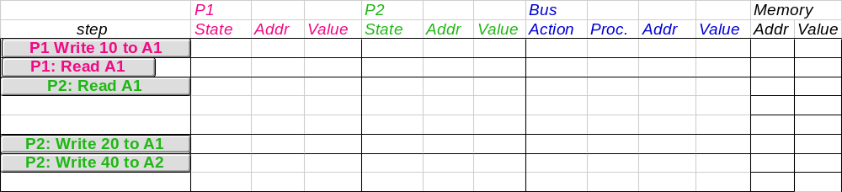
Example
Assumes A1 and A2 map to same cache block,
initial cache state is invalid

Slide 83
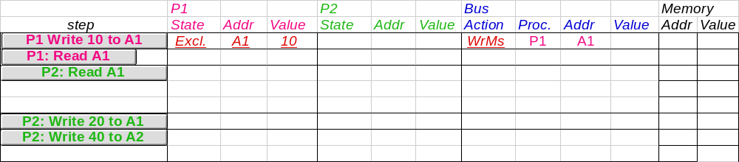
Example
Assumes A1 and A2 map to same cache block

Slide 84
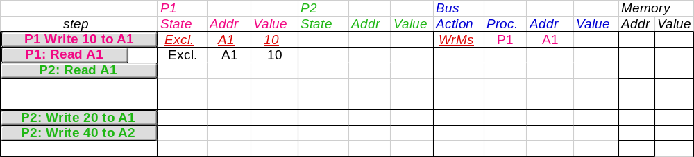
Example
Assumes A1 and A2 map to same cache block

Slide 85
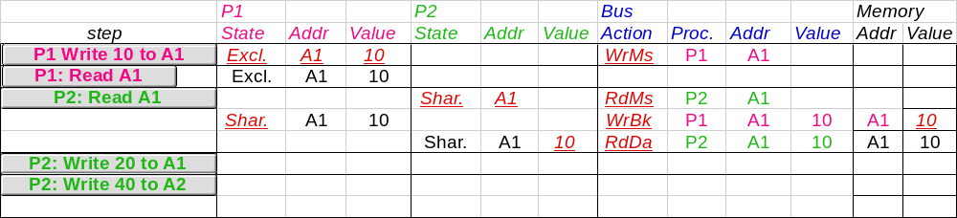
Example
Assumes A1 and A2 map to same cache block

Slide 86
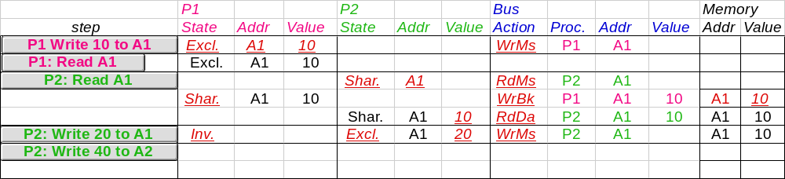
Example
Assumes A1 and A2 map to same cache block

Slide 87
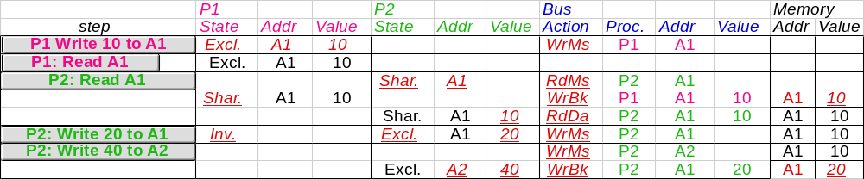
Example
Assumes A1 and A2 map to same cache block,
but A1 != A2
Notes:
Why write miss first?
Because in general, only write a piece of block, may need to read it first so that can have a full vblock; therefore, need to get
Write back is low priority event.

Slide 88
Implementation Complications
Write Races:
  Cannot update cache until bus is obtained
    Otherwise, another processor may get bus first,
    and then write the same cache block!
  Two step process:
    Arbitrate for bus
    Place miss on bus and complete operation
  If miss occurs to block while waiting for bus,
  handle miss (invalidate may be needed) and then restart.
  Split transaction bus:
    Bus transaction is not atomic:
    can have multiple outstanding transactions for a block
    Multiple misses can interleave,
    allowing two caches to grab block in the Exclusive state
    Must track and prevent multiple misses for one block
Must support interventions and invalidations

Slide 89
Implementing Snooping Caches
Multiple processors must be on bus, access to both addresses and data
Add a few new commands to perform coherency,
in addition to read and write
Processors continuously snoop on address bus
  If address matches tag, either invalidate or update
Since every bus transaction checks cache tags,
could interfere with CPU just to check:
  solution 1: duplicate set of tags for L1 caches just to allow checks in parallel with CPU
  solution 2: L2 cache already duplicate, provided L2 obeys inclusion with L1 cache

Slide 90
Implementing Snooping Caches
Bus serializes writes, getting bus ensures no one else can perform memory operation
On a miss in a write back cache, may have the desired copy and its dirty, so must reply
Add extra state bit to cache to determine shared or not
Add 4th state (MESI)
  Modfied (private,!=Memory)
  eXclusive (private,=Memory)
  Shared (shared,=Memory)
  Invalid

Slide 91
MESI Highlights
From local processor P’s viewpoint, for each cache block
Modified: Only P has a copy and the copy has been modifed; must respond to any read/write request
Exclusive-clean: Only P has a copy and the copy is clear; no need to inform others about my changes
Shared: Some other machines else may have copy; have to inform others about P’s changes
Invalid: The block has been invalidated (possibly on the request of someone else)

Slide 92
MESI Highlights
Actions:
Have read misses on a block: send read request onto bus
Have write misses on a block: send write request onto bus
Receive bus read request: transit the block to shared state
Receive bus write request: transit the block to invalid state
Must write back data when transiting from modified state

